Slide 1
Introduction to Intermediate Machine Learning: From Theory to Practice with KNN, SVM, Decision Trees, and Random Forests (RF) and Extreme Gradient Boosting (XGBoost)
Prepared and Delivered by:
Lumumba Wandera Victor

Slide 2
Introduction to Machine Learning
What is Machine Learning
Machine Learning (ML) refers to the ability of machines to learn from data and make decisions or predictions based on that data without human intervention.
Instead of being explicitly programmed to perform specific tasks, machine learning models improve their performance by identifying patterns in large datasets and adapting their behavior accordingly.
These models can be used for tasks like classification, regression, clustering, and more.

Slide 3
Differences Between AI, ML, and Deep Learning:
1. Artificial Intelligence (AI):
Definition: AI is the broadest concept and refers to the simulation of human intelligence by machines. It involves the creation of systems capable of performing tasks that typically require human intelligence, such as visual perception, speech recognition, decision-making, and language translation.
Scope: AI includes both rule-based systems (e.g., if-then logic) and learning systems (like machine learning and deep learning).
Techniques Used: AI uses various techniques, including search algorithms, expert systems, and learning-based approaches like ML and DL.
Example: A chatbot that can hold a conversation or an autonomous car that can drive itself.

Slide 4
Machine Learning (ML):
Definition: ML is a subset of AI that focuses specifically on systems that can learn from data. In ML, algorithms are trained on datasets to recognize patterns, make predictions, or improve their accuracy over time without being explicitly programmed for specific tasks.
Scope: ML is narrower than AI, as it deals solely with learning from data. It covers a range of techniques such as supervised learning, unsupervised learning, and reinforcement learning.
Techniques Used: Popular algorithms include decision trees, support vector machines (SVM), k-nearest neighbors (k-NN), and neural networks.
Example: A spam filter that learns to classify emails as spam or not spam based on previous examples.

Slide 5
Deep Learning (DL):
Definition: DL is a specialized subfield of ML, focusing on neural networks with many layers (hence "deep"). These networks are capable of learning complex representations from massive amounts of data and are particularly effective in tasks involving images, audio, and natural language.
Scope: Deep learning is more specific than ML, as it deals with neural networks that have multiple hidden layers (hence the term "deep"). It is often applied in scenarios where large amounts of data and high computational power are available.
Techniques Used: Deep learning uses architectures like Convolutional Neural Networks (CNNs) for image recognition, Recurrent Neural Networks (RNNs) for time-series data or language processing, and transformers for advanced NLP tasks.
Example: A self-driving car’s vision system that processes camera inputs and recognizes objects, or an image recognition system classifying images of cats and dogs.

Slide 6
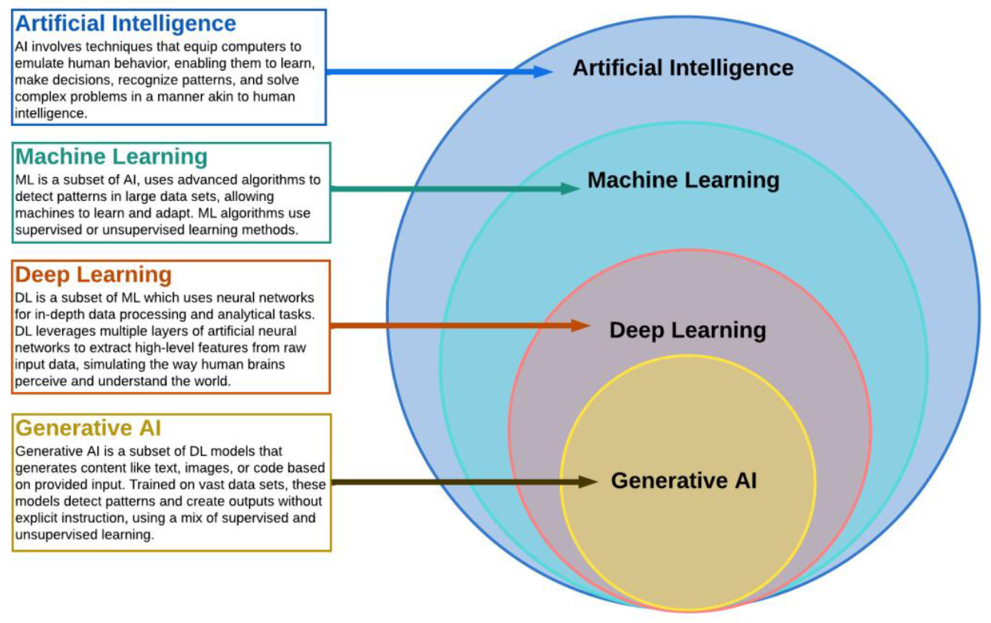
Diagrammatic Representation of AI, ML, and Deep Learning

Slide 7
Difference Between AI, ML and Deep Learning
Aspect | Artificial Intelligence (AI) | Machine Learning (ML) | Deep Learning (DL)
Scope | Broad: Encompasses any intelligent behavior | Narrower: Focuses on data-driven learning systems | Narrowest: Specializes in multi-layered neural networks
Techniques | Rule-based, symbolic reasoning, ML included | Supervised, unsupervised, and reinforcement learning | Neural networks with many layers (e.g., CNNs, RNNs)
Complexity | Handles simple and complex tasks | Solves data-driven problems with structured data | Handles very complex tasks like image and language understanding
Data Requirement | Varies, may not need large datasets | Requires structured data for training | Requires massive amounts of data for training
Examples | Chatbots, robotic process automation | Email spam detection, recommendation engines | Autonomous vehicles, speech recognition systems

Slide 8
Types of Machine Learning
Supervised Learning:
Supervised learning involves training a model using labeled data, where both the input data and the corresponding output labels are provided.
The model learns to map inputs to outputs based on these examples, allowing it to make predictions or classifications for new, unseen data. It can be applied to two main types of problems:

Slide 9
Classification
Goal: To predict a categorical output (label) from input data. The output can belong to one of several predefined classes.
How it Works: The algorithm learns from a labeled dataset where the categories are known. Once trained, the model can classify new data points into one of the classes.
Examples:
  Email Spam Detection: Classifying emails as "spam" or "not spam."
  Image Classification: Identifying whether an image contains a dog, cat, or bird.
Common Algorithms:
  Logistic Regression
  Support Vector Machines (SVM)
  k-Nearest Neighbors (k-NN)
  Decision Trees, Random Forests

Slide 10
Regression
Goal: To predict a continuous numerical output based on input data.
How it Works: The model is trained on a dataset where the output is a real number (continuous variable). It learns to predict the value based on the input features.
Examples:
  House Price Prediction: Predicting the price of a house based on factors like size, location, and age.
  Stock Price Forecasting: Predicting future stock prices based on historical data.
Common Algorithms:
  Linear Regression
  Polynomial Regression
  Decision Trees, Random Forests (for regression tasks)
  Support Vector Machines (SVM)
  Support Vector Regression (SVR)

Slide 11
Unsupervised Learning
Unsupervised learning is used when the data does not have labeled outputs. The algorithm tries to discover hidden patterns, structures, or relationships in the data without being explicitly guided.
It is mainly used for the following tasks:

Slide 12
Clustering
Goal: To group similar data points into clusters based on their features, with the aim of finding inherent patterns or structures.
How it Works: The algorithm attempts to find groups in the data based on feature similarity. The data points within a cluster are more similar to each other than to those in other clusters.
Examples:
  Customer Segmentation: Grouping customers based on purchasing behavior to identify distinct market segments.
  Image Segmentation: Clustering pixels in an image to distinguish between different regions or objects.
Common Algorithms:
  k-Means Clustering
  Hierarchical Clustering
  DBSCAN (Density-Based Spatial Clustering of Applications with Noise)

Slide 13
Dimensionality Reduction
Goal: To reduce the number of features (dimensions) in a dataset while preserving as much relevant information as possible.
How it Works: The algorithm transforms high-dimensional data into a lower-dimensional space, often for visualization or to improve the efficiency of other algorithms (like clustering or classification).
Examples:
  Principal Component Analysis (PCA): Used to reduce the number of variables while retaining most of the variance in the data.
  t-Distributed Stochastic Neighbor Embedding (t-SNE): Often used for visualizing high-dimensional data in 2D or 3D.
Common Algorithms:
  Principal Component Analysis (PCA)
  t-SNE
  Autoencoders (in deep learning)

Slide 14
REINFORCEMENT LEARNING
Goal: To train an agent to make a sequence of decisions by interacting with an environment to maximize cumulative rewards.
How it Works: The agent learns by trial and error, receiving feedback from its actions in the form of rewards or penalties. The goal is to maximize the total reward over time by learning an optimal policy for decision-making.
Examples:
  Game Playing: Reinforcement learning is used to train agents to play games like chess or Go (e.g., AlphaGo).
  Robotics: Training robots to perform tasks by interacting with their environment and learning the best actions to take.

Slide 15
Key Concepts
  Agent: The learner or decision-maker.
  Environment: The world with which the agent interacts.
  Action: A move the agent makes within the environment.
  Reward: The feedback the agent receives after performing an action, which could be positive or negative.
  Policy: The strategy the agent uses to decide its next action based on the current state.
Common Algorithms:
  Q-Learning
  Deep Q-Networks (DQN)
  Proximal Policy Optimization (PPO)

Slide 16
Tabular Differences
Learning Type | Goal | Common Tasks | Key Algorithms | Example Applications
Supervised Learning | Learn from labeled data to make predictions or classifications | - Classification (spam detection) | - Logistic Regression | - Fraud detection
 |  | - Regression (price prediction) | - Random Forest | - House price prediction
 |  |  | - SVM
Unsupervised Learning | Discover hidden patterns in unlabeled data | - Clustering (customer segmentation) | - k-Means | - Market segmentation
 |  | - Dimensionality reduction (PCA) | - Hierarchical Clustering | - Data visualization
 |  |  | - PCA
Reinforcement Learning | Learn optimal actions through trial and error to maximize reward | - Decision-making (games, robotics) | - Q-Learning | - Autonomous driving
 |  |  | - Deep Q-Networks (DQN) | - Game AI
 |  |  | - Proximal Policy Optimization (PPO)

Slide 17
Supervised Learning Workflow
Problem Formulation
Data collection and preparation.
Train-Test split.
Model training and evaluation.
Model tuning and deployment.

Slide 18
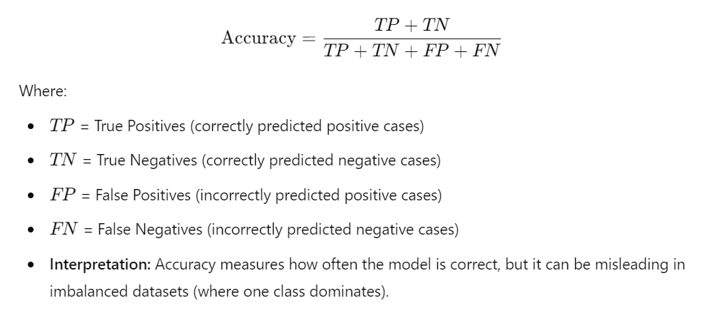
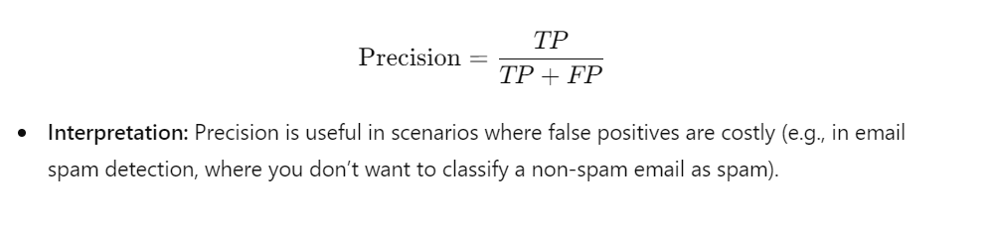
Evaluation Metrics for Classification
Precision (Positive Predictive Value)
Definition: Precision is the proportion of true positive predictions out of all positive predictions made by the model. It answers the question: "Of all the instances predicted as positive, how many are actually positive?"
Accuracy
Definition: Accuracy is the proportion of correctly classified instances (both true positives and true negatives) out of all instances.

Slide 19
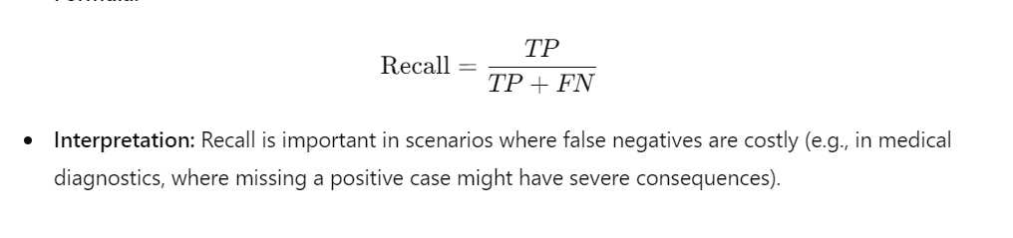
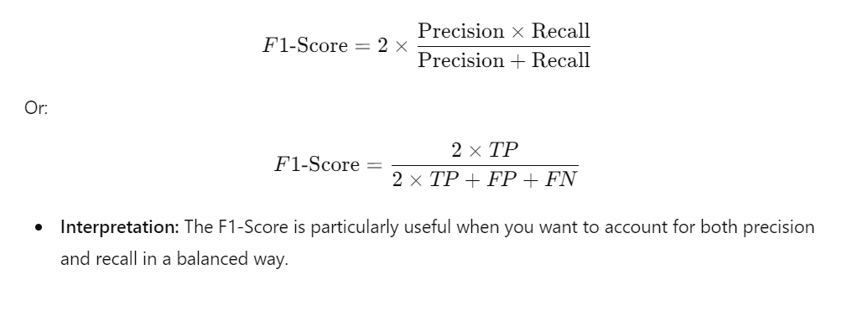
Evaluation Metrics for Classification
Recall (Sensitivity, True Positive Rate)
Definition: Recall is the proportion of actual positive cases that were correctly predicted by the model. It answers the question: "Of all the actual positive instances, how many were correctly predicted?"
F1-Score
Definition: The F1-Score is the harmonic mean of Precision and Recall. It provides a single metric that balances both precision and recall, especially useful when the class distribution is imbalanced.

Slide 20
Confusion Matrix
Definition: The confusion matrix is a table that summarizes the performance of a classification algorithm by comparing the predicted labels with the actual labels.
It shows the number of true positives (TP), true negatives (TN), false positives (FP), and false negatives (FN).
A typical confusion matrix looks like this for binary classification:

Slide 21
Confusion Matrix
 | Predicted Positive | Predicted Negative
Actual Positive | True Positive (TP) | False Negative (FN)
Actual Negative | False Positive (FP) | True Negative (TN)

Slide 22
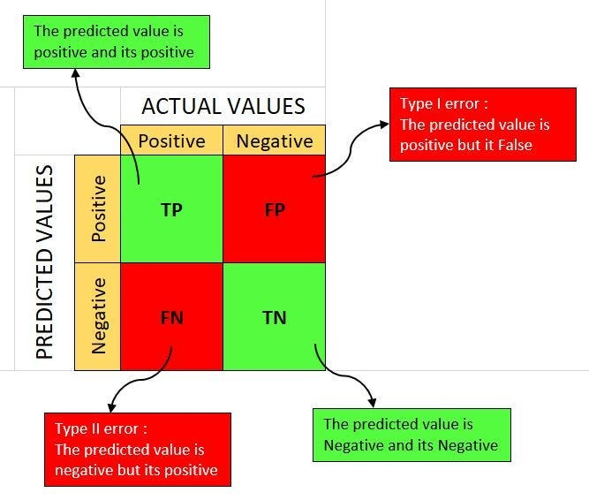
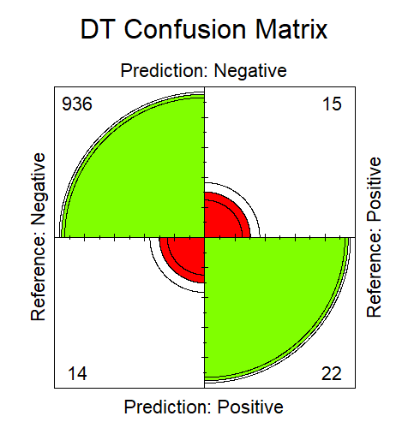
Alternative Graphical for Confusion Matrix

Slide 23
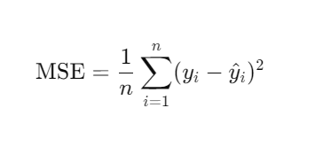
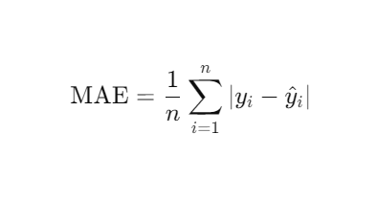
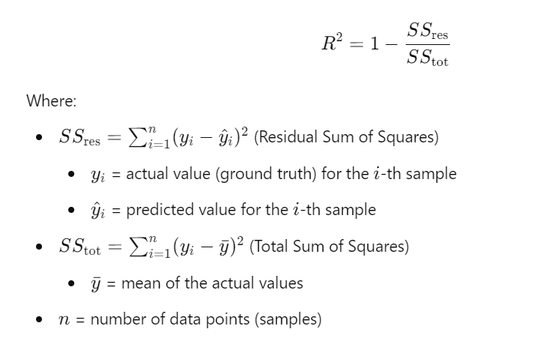
Evaluation Metrics for Regression
Mean Absolute Error (MAE)
Mean Squared Error (MSE)
R-Squared.

Slide 24
Module 2: Machine Learning Algorithms

Slide 25
Key Algorithms for Classification, Regression and Clustering
Supervised Learning
1. Classification Algorithms:
K-NN
SVM
Decision Tree
Random Forest etc.
2. Regression Algorithms
K-NN
SVM
Random Forest
Extreme Gradient Boosting (XGBoost) etc.
Unsupervised Learning
1. Clustering
K-Means Clustering
Hierarchical Clustering
2. Principle Component Analysis
Reinforcement Learning

Slide 26
Classification Algorithms
Logistic Regression:
Used for binary and multi-class classification tasks.
Based on the logistic function, it estimates the probability that a given instance belongs to a specific class.
Suitable for problems like spam detection or determining whether a customer will churn.
K-Nearest Neighbors (K-NN):
A simple, instance-based learning algorithm.
Classifies new data points based on the majority class among the K-nearest points in the feature space.
Effective for tasks like image classification and recommendation systems.
Support Vector Machines (SVM):
Works by finding a hyperplane that best separates data points from different classes.
Particularly useful for high-dimensional spaces and complex decision boundaries.
Commonly applied to text classification and image recognition tasks.

Slide 27
Cont.’
Decision Trees:
A tree-like model where data is split based on feature values.
Each internal node represents a feature, and each leaf node represents a class label.
Easy to interpret and can handle both categorical and numerical data.
Random Forest:
An ensemble learning method that builds multiple decision trees and combines their outputs.
Provides better accuracy than individual decision trees by reducing overfitting.
Widely used in applications such as fraud detection and medical diagnosis.
Naive Bayes:
Based on Bayes’ Theorem and assumes that features are independent given the class label.
A fast and efficient classifier, often used for text classification and spam filtering.
XGBoost (Extreme Gradient Boosting):
An advanced version of gradient boosting that is highly efficient and scalable.
Often achieves state-of-the-art results in classification tasks like customer churn prediction and financial risk modeling.

Slide 28
Regression Algorithms
Linear Regression:
  One of the simplest algorithms, where the relationship between input features and output is modeled as a linear function.
  Used in tasks like predicting house prices or sales forecasting.
Ridge Regression:
  A regularized form of linear regression that adds a penalty to the size of the coefficients to prevent overfitting.
  Effective when dealing with multicollinearity in datasets.
Lasso Regression:
  Similar to Ridge Regression but uses L1 regularization, which can shrink some coefficients to zero, making it useful for feature selection.
  Often used in scenarios with many features, such as gene selection in bioinformatics.
Support Vector Regression (SVR):
  A regression version of the SVM algorithm.
  SVR tries to fit the best line within a margin, minimizing the error while also reducing overfitting.
  Suitable for predicting continuous values like stock prices or temperature.

Slide 29
Continuation
Decision Trees for Regression:
  Like decision trees for classification, but the outputs are continuous values.
  Splits data based on feature values and predicts the mean value of the target variable for each leaf node.
  Used for regression tasks like predicting energy consumption or income levels.
Random Forest for Regression:
  Similar to Random Forest for classification but applied to regression problems.
  Combines the predictions of multiple decision trees to improve accuracy and reduce overfitting.
  Used in applications like predicting car prices or credit risk.
XGBoost for Regression:
  An optimized version of gradient boosting that works well for large-scale regression tasks.
  It iteratively improves predictions by combining weak learners.
  Commonly used in competitive data science challenges and for time series forecasting.

Slide 30
Machine Learning Flow Chart

Slide 31
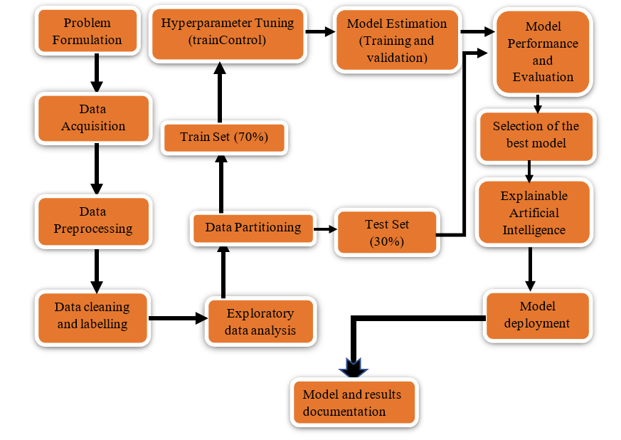
Steps in Machine Learning

Slide 32
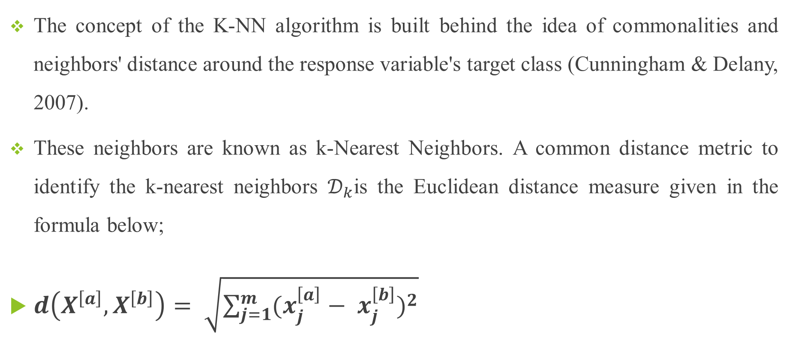
K-Nearest Neighbors (KNN)
The concept of the K-NN algorithm is built behind the idea of commonalities and neighbors' distance around the response variable's target class (Cunningham & Delany, 2007).
These neighbors are known as k-Nearest Neighbors. A common distance metric to identify the k-nearest neighbors $𝒟_{k}$is the Euclidean distance measure given in the formula below;
$d\left(X^{\left[a\right]}, X^{\left[b\right]}\right)= \sqrt{\sum_{j=1}^{m}{{(x_{j}^{\left[a\right]}− x_{j}^{\left[b\right]})}^{2}}}$

Slide 33
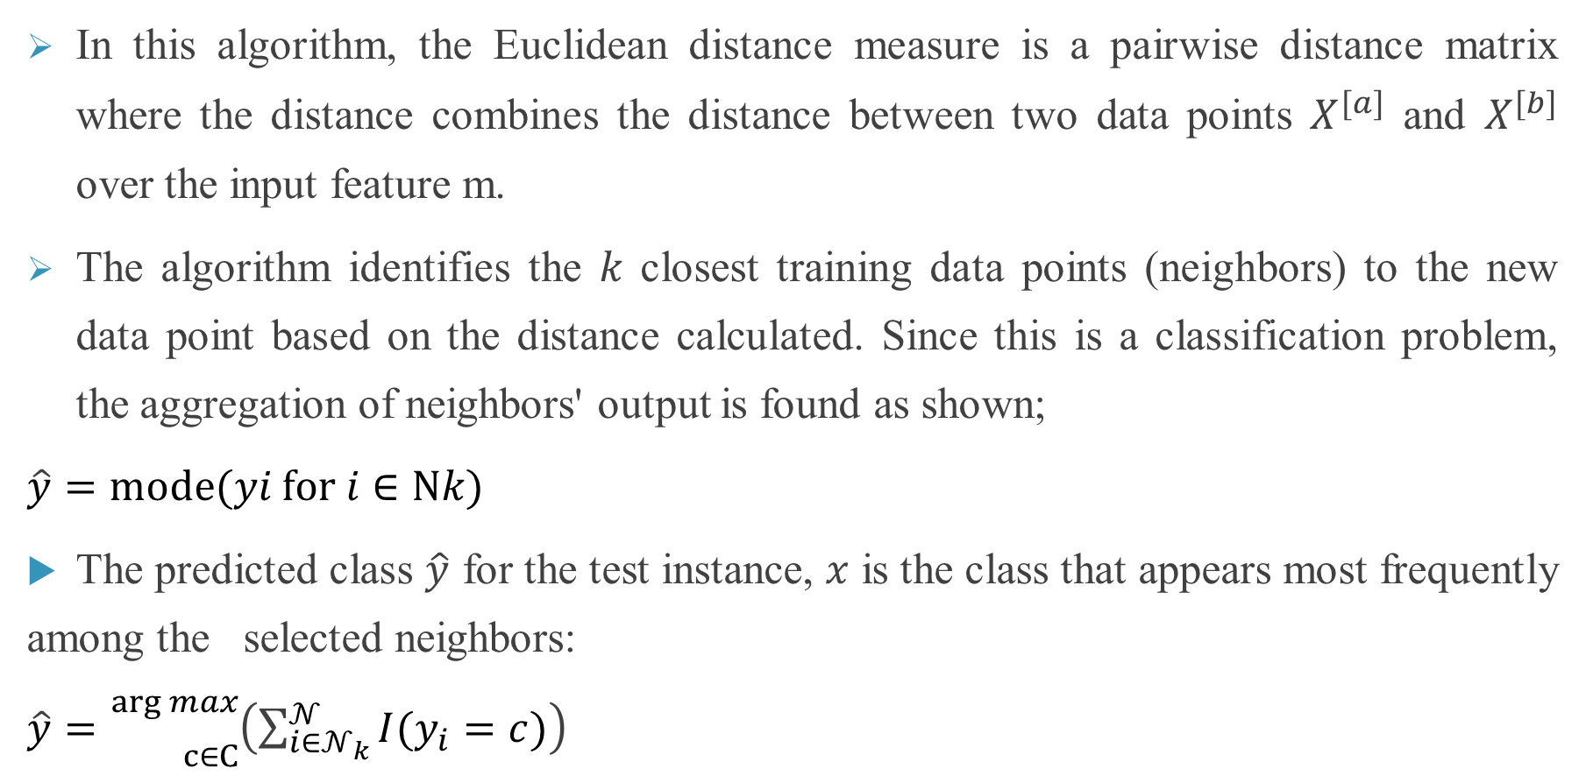
K-NN Continuation
In this algorithm, the Euclidean distance measure is a pairwise distance matrix where the distance combines the distance between two data points $X^{[a]}$ and $X^{[b]}$ over the input feature m.
The algorithm identifies the 𝑘 closest training data points (neighbors) to the new data point based on the distance calculated. Since this is a classification problem, the aggregation of neighbors' output is found as shown;
$\hat{y}​=mode(yi​ for i∈Nk​)$
The predicted class $\hat{y}$ for the test instance, 𝑥 is the class that appears most frequently among the selected neighbors:
$\hat{y}​={}_{c∈C}^{\arg{max}}{\left(\sum_{i∈𝒩_{k}}^{𝒩}{I(y_{i}=c)}\right)}$

Slide 34
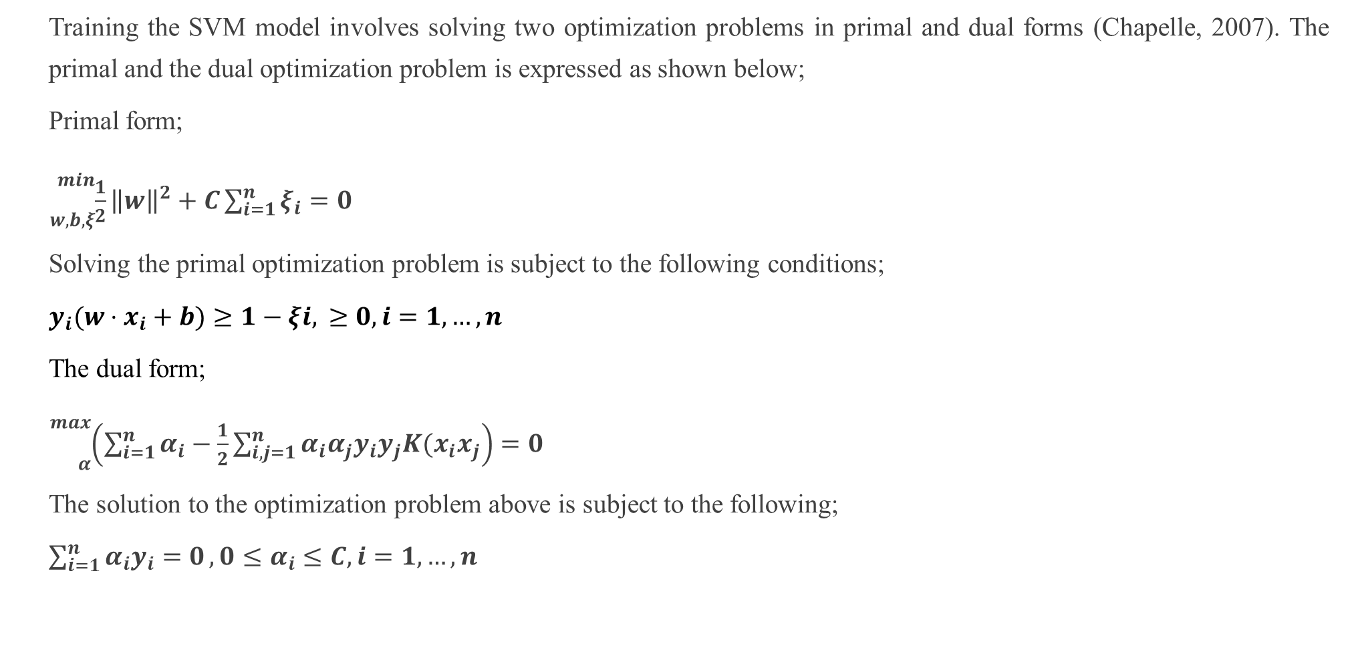
Support Vector Machine (SVM)
Training the SVM model involves solving two optimization problems in primal and dual forms (Chapelle, 2007). The primal and the dual optimization problem is expressed as shown below;
Primal form;
${}_{w,b,ξ}^{min}{\frac{1}{2}{\left\|w\right\|}^{2}+C\sum_{i=1}^{n}{ξ_{i}}}=0$
Solving the primal optimization problem is subject to the following conditions;
$y_{i}​(w⋅x_{i}+b)≥1−ξi​,​≥0,i=1,…,n$
The dual form;
${}_{α}^{max}{\left(\sum_{i=1}^{n}{α_{i}}−\frac{1}{2}\sum_{i,j=1}^{n}{α_{i}α_{j}y_{i}y_{j}K(x_{i}x_{j}}\right)}=0$
The solution to the optimization problem above is subject to the following;
$\sum_{i=1}^{n}{α_{i}y_{i}=0}, 0≤α_{i}≤C, i=1,…,n$

Slide 35
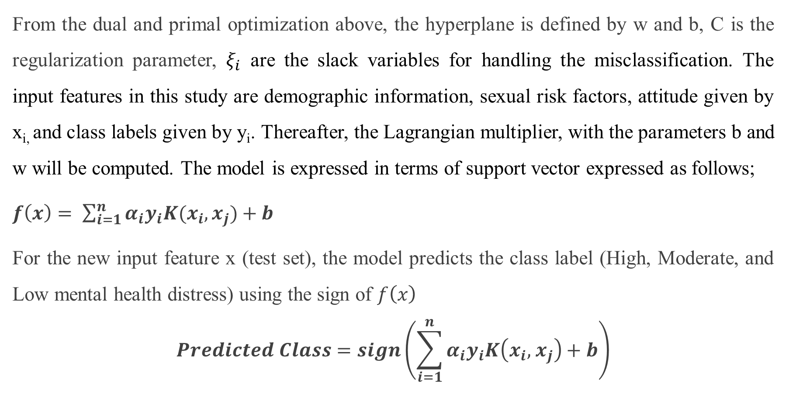
Continuation of SVM
From the dual and primal optimization above, the hyperplane is defined by w and b, C is the regularization parameter, $ξ_{i}$ are the slack variables for handling the misclassification. The input features in this study are demographic information, sexual risk factors, attitude given by x_{i,} and class labels given by y_{i}. Thereafter, the Lagrangian multiplier, with the parameters b and w will be computed. The model is expressed in terms of support vector expressed as follows;
$f\left(x\right)= \sum_{i=1}^{n}{α_{i}y_{i}K(x_{i}, x_{j}})+b$
For the new input feature x (test set), the model predicts the class label (High, Moderate, and Low mental health distress) using the sign of $f\left(x\right)$
$$Predicted Class=sign\left(\sum_{i=1}^{n}{α_{i}y_{i}K\left(x_{i},{ x}_{j}\right)+b}\right)$$

Slide 36
Decision Trees
A Decision tree is a supervised learning algorithm used for both classification and regression tasks. It is a tree-like structure where:
Internal nodes represent a decision based on the value of a feature.
Branches represent the outcome of the decision, splitting the data based on a feature's value.
Leaf nodes represent the final decision or output (class label or continuous value).
How it Works:
The dataset is split into subsets based on the most significant feature.
At each step, the algorithm chooses the feature that best separates the data, using criteria like Gini Impurity or Information Gain.
The tree grows until it reaches a stopping condition, such as a maximum depth or a minimum number of samples per leaf.

Slide 37
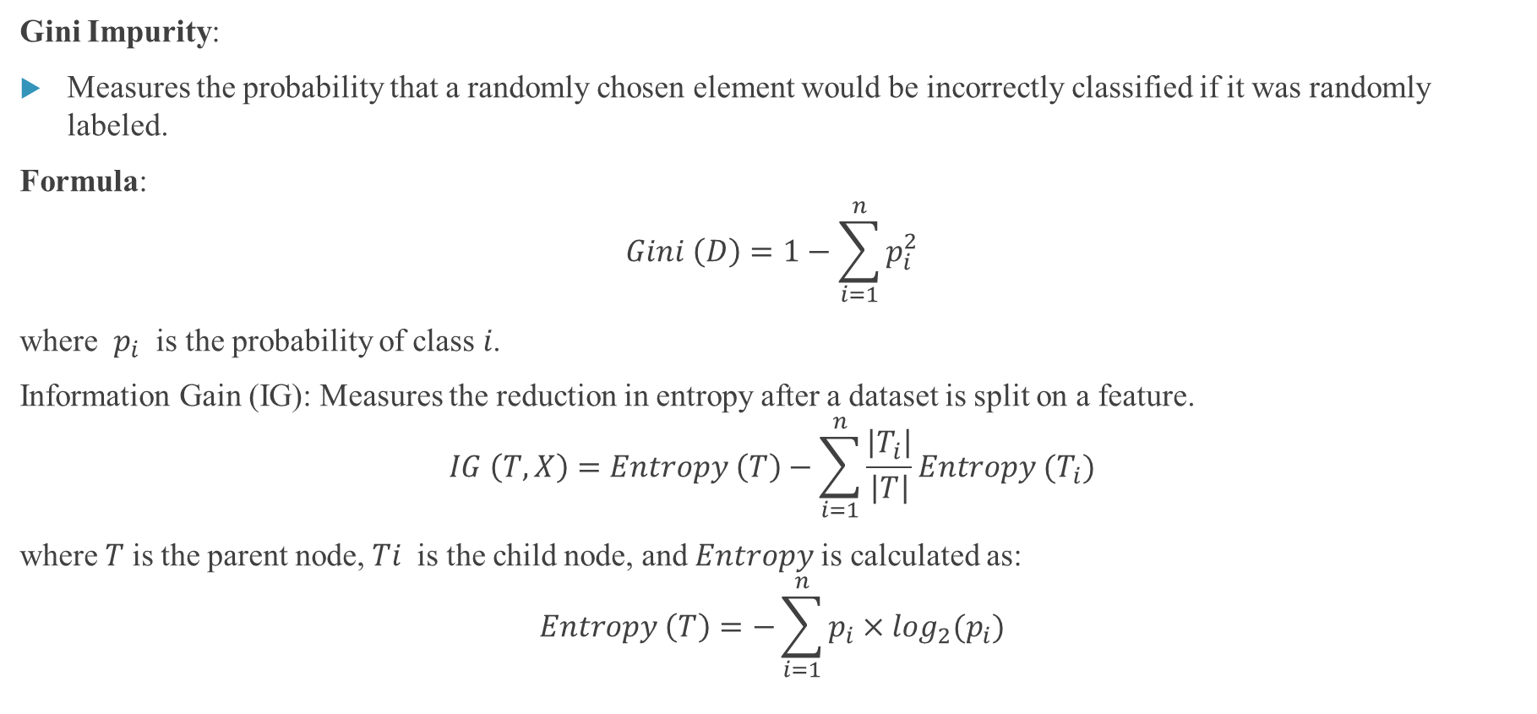
Continuation of the Decision Tree
Gini Impurity:
Measures the probability that a randomly chosen element would be incorrectly classified if it was randomly labeled.
Formula:
$$Gini \left(D\right)=1−\sum_{i=1}^{n}{p_{i}^{2}}$$
where $p_{i}$​ is the probability of class 𝑖.
Information Gain (IG): Measures the reduction in entropy after a dataset is split on a feature.
$$IG \left(T, X\right)=Entropy \left(T\right)−\sum_{i=1}^{n}{\frac{\left|T_{i}\right|}{\left|T\right|}}Entropy (T_{i})$$
where 𝑇 is the parent node, 𝑇𝑖​ is the child node, and 𝐸𝑛𝑡𝑟𝑜𝑝𝑦 is calculated as:
$$Entropy \left(T\right)=−\sum_{i=1}^{n}{p_{i}×\log_{2}(p_{i})}$$

Slide 38
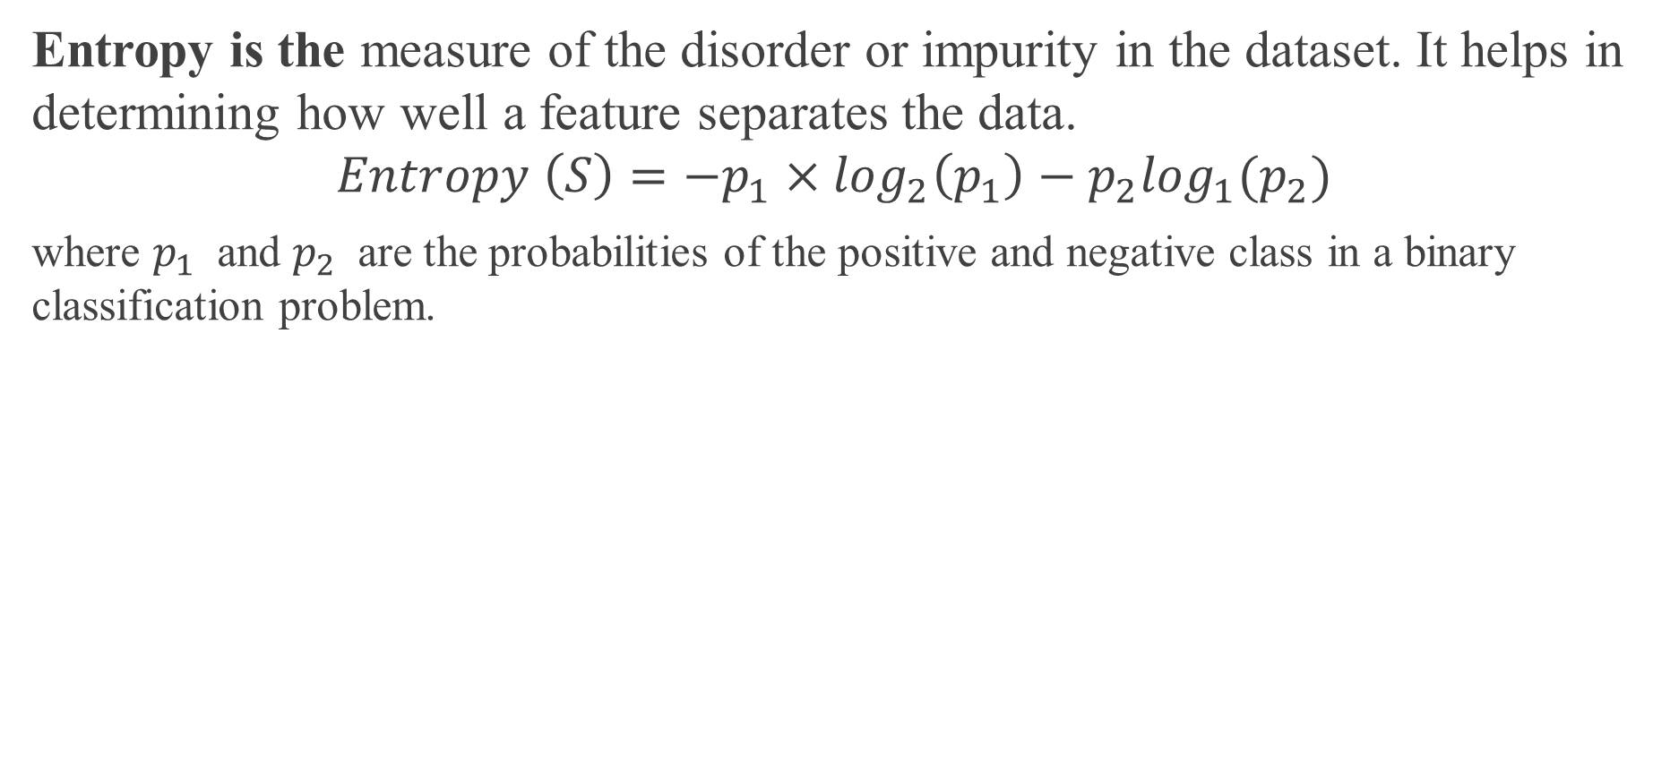
What is an Entropy
Entropy is the measure of the disorder or impurity in the dataset. It helps in determining how well a feature separates the data.
$$Entropy \left(S\right)=−p_{1}×\log_{2}\left(p_{1}\right)−p_{2}\log_{1}(p_{2})$$
where $p_{1}$​ and $p_{2}$​ are the probabilities of the positive and negative class in a binary classification problem.

Slide 39
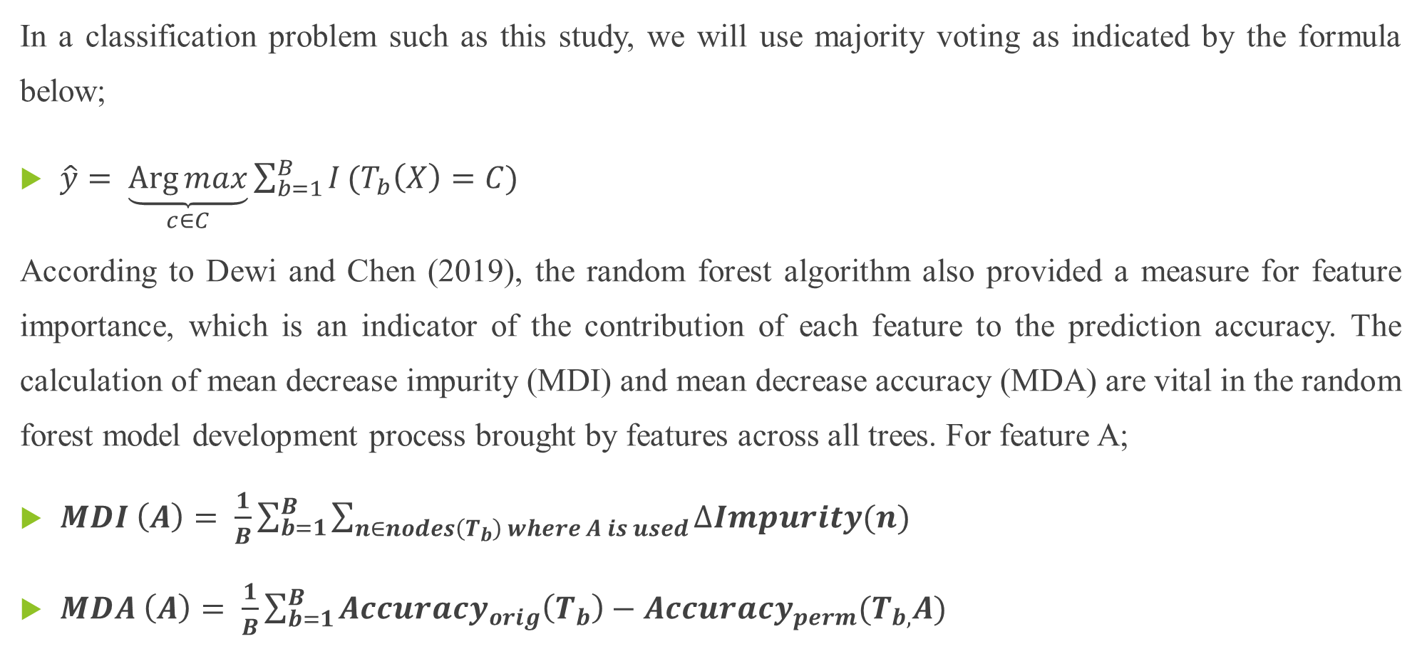
Random Forest
In a classification problem such as this study, we will use majority voting as indicated by the formula below;
$\hat{y}= \underset{c∈C}{\underbrace{\operatorname{Arg}{max}}}\sum_{b=1}^{B}{I}(T_{b}\left(X\right)=C)$
According to Dewi and Chen (2019), the random forest algorithm also provided a measure for feature importance, which is an indicator of the contribution of each feature to the prediction accuracy. The calculation of mean decrease impurity (MDI) and mean decrease accuracy (MDA) are vital in the random forest model development process brought by features across all trees. For feature A;
$MDI \left(A\right)= \frac{1}{B}\sum_{b=1}^{B}{\sum_{n∈nodes\left(T_{b}\right) where A is used}{∆Impurity(n)}}$
$MDA \left(A\right)= \frac{1}{B}\sum_{b=1}^{B}{{Accuracy}_{orig}\left(T_{b}\right)−{Accuracy}_{perm}(T_{b,}A)}$

Slide 40
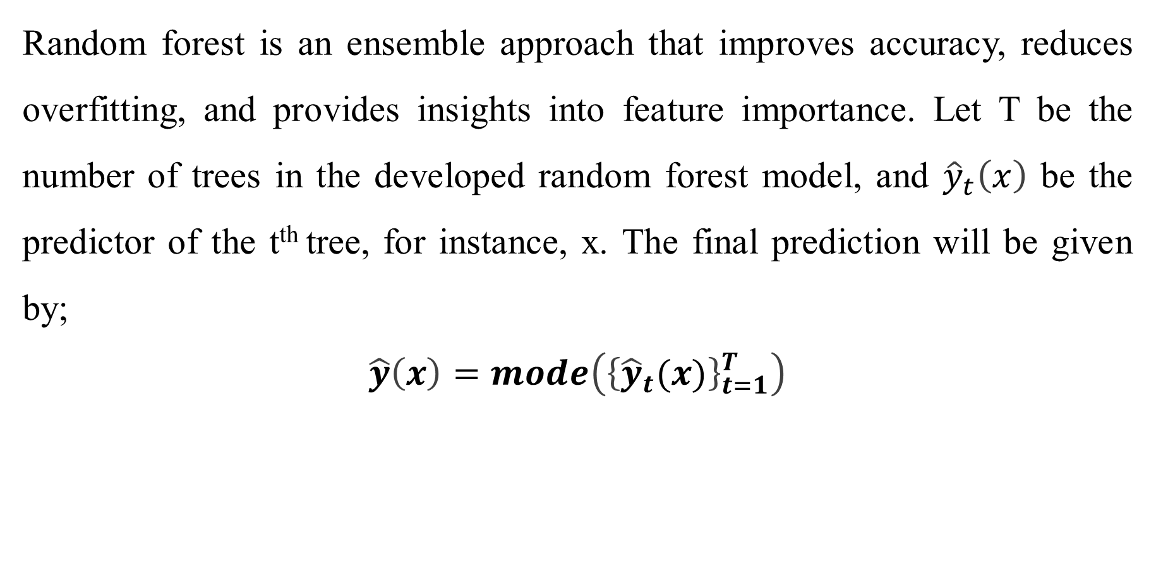
Continuation of the Random Forest
Random forest is an ensemble approach that improves accuracy, reduces overfitting, and provides insights into feature importance. Let T be the number of trees in the developed random forest model, and ${\hat{y}}_{t}\left(x\right)$ be the predictor of the t^{th} tree, for instance, x. The final prediction will be given by;
$$\hat{y}\left(x\right)=mode\left({\left\{{\hat{y}}_{t}(x)\right\}}_{t=1}^{T}\right)$$

Slide 41
Model Evaluation, Tuning, Handling Class Imbalance & Case Studies

Slide 42
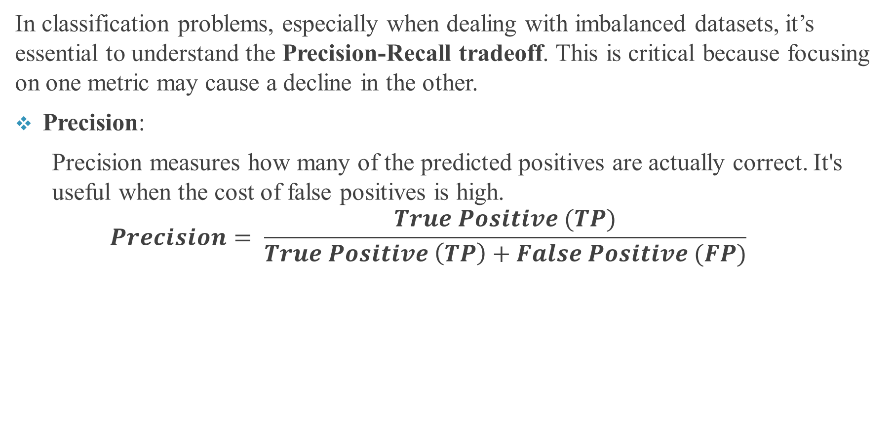
Model Evaluation: Key Concepts
In classification problems, especially when dealing with imbalanced datasets, it’s essential to understand the Precision-Recall tradeoff. This is critical because focusing on one metric may cause a decline in the other.
Precision:
  Precision measures how many of the predicted positives are actually correct. It's useful when the cost of false positives is high.
  $$Precision= \frac{True Positive (TP)}{True Positive \left(TP\right)+False Positive (FP)}$$

Slide 43
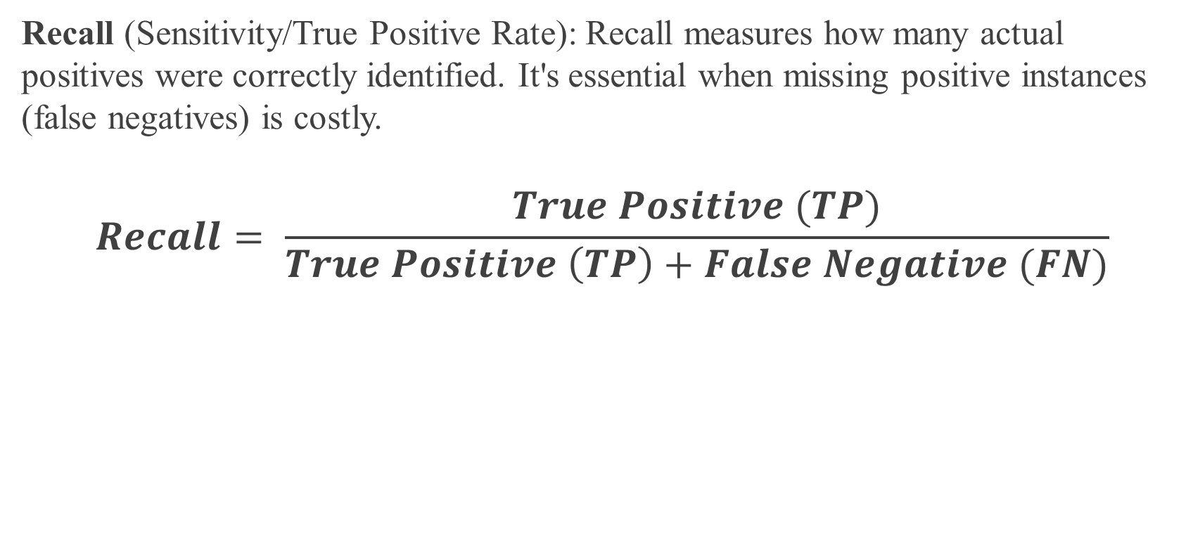
Metric Evaluation
Recall (Sensitivity/True Positive Rate): Recall measures how many actual positives were correctly identified. It's essential when missing positive instances (false negatives) is costly.
$$Recall= \frac{True Positive (TP)}{True Positive \left(TP\right)+False Negative (FN)}$$

Slide 44
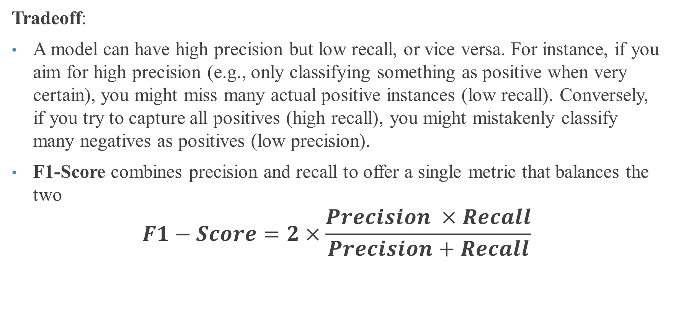
Evaluation Metrics
Tradeoff:
A model can have high precision but low recall, or vice versa. For instance, if you aim for high precision (e.g., only classifying something as positive when very certain), you might miss many actual positive instances (low recall). Conversely, if you try to capture all positives (high recall), you might mistakenly classify many negatives as positives (low precision).
F1-Score combines precision and recall to offer a single metric that balances the two
$$F1−Score=2×\frac{Precision ×Recall}{Precision+Recall}$$

Slide 45
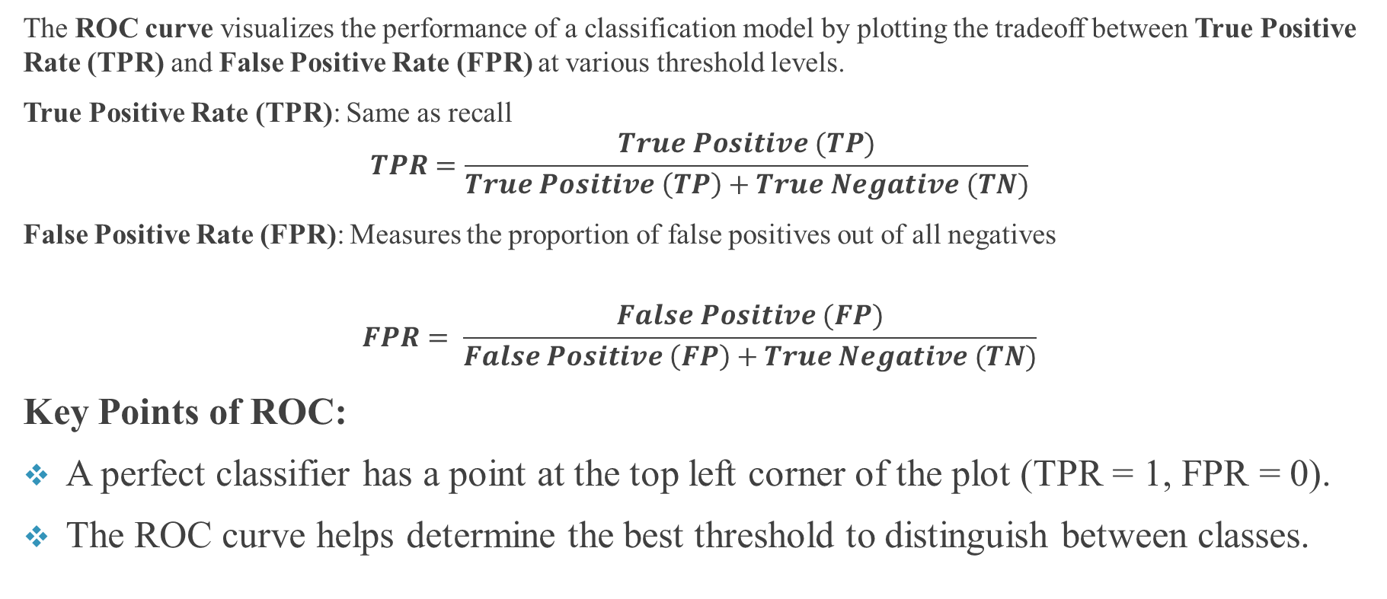
ROC (Receiver Operating Characteristic) Curve
The ROC curve visualizes the performance of a classification model by plotting the tradeoff between True Positive Rate (TPR) and False Positive Rate (FPR) at various threshold levels.
True Positive Rate (TPR): Same as recall
$$TPR=\frac{True Positive (TP)}{True Positive \left(TP\right)+True Negative (TN)}$$
False Positive Rate (FPR): Measures the proportion of false positives out of all negatives
$$FPR= \frac{False Positive (FP)}{False Positive \left(FP\right)+True Negative (TN)}$$
Key Points of ROC:
A perfect classifier has a point at the top left corner of the plot (TPR = 1, FPR = 0).
The ROC curve helps determine the best threshold to distinguish between classes.

Slide 46
AUC (Area Under the Curve)
AUC (Area Under the Curve) is the area under the ROC curve, providing a single value to summarize the model's performance.
AUC ranges between 0 and 1:
  AUC = 1: Perfect classifier.
  AUC = 0.5: Random guessing.
  AUC < 0.5: Worse than random guessing.
The closer the AUC is to 1, the better the model.

Slide 47
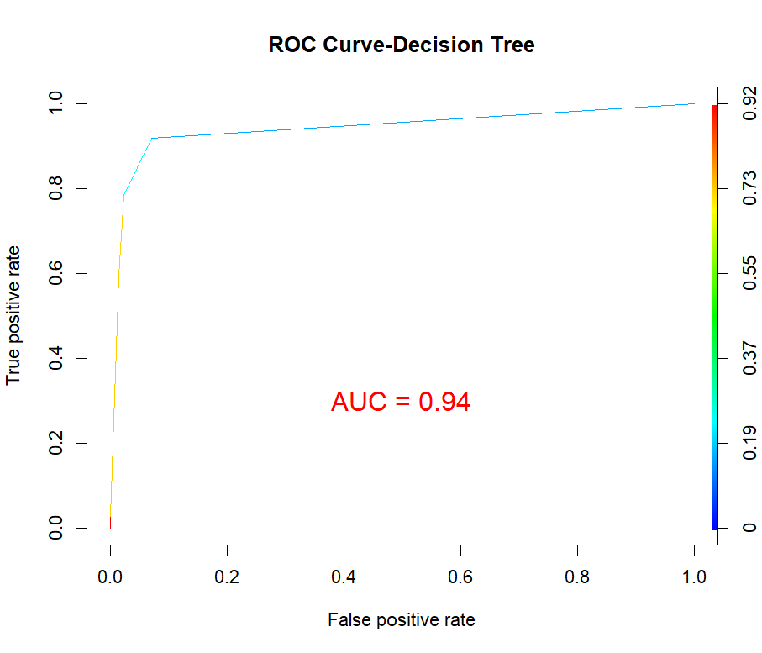
An Example of ROC and AUC

